Slide 1

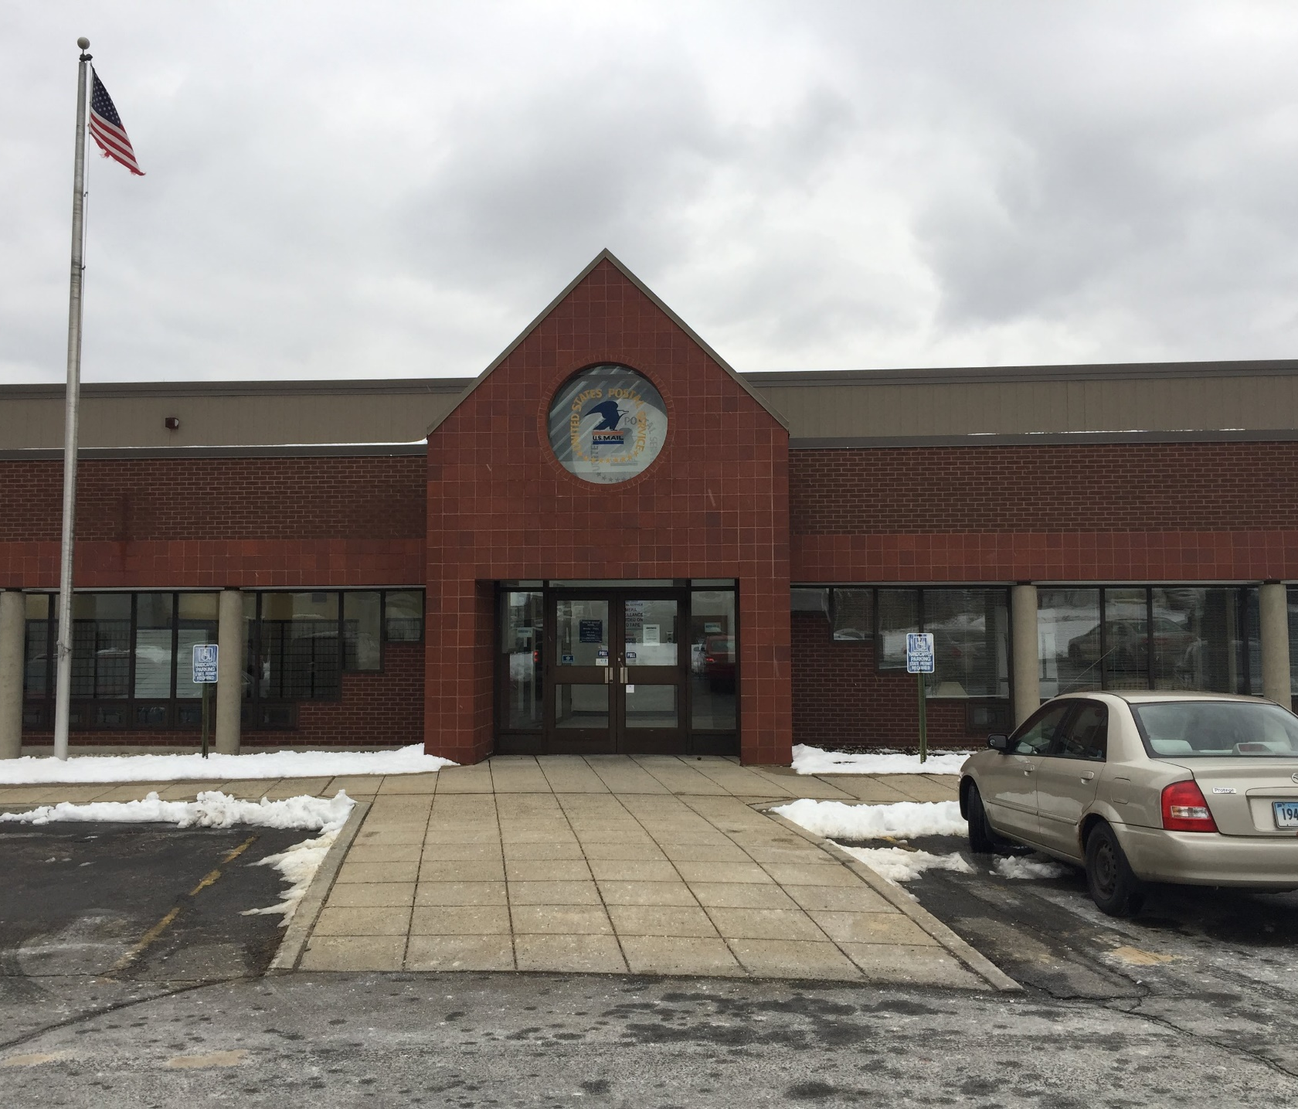
Simulation Modelling
By TEAM SUPER SIMULATION
DANIYAL A FAHEEM
HU YIXUAN
LAKSHMI MANGALA KODURI

Slide 2
INTRODUCTION
The United States Postal Service is an independent agency of the U.S Federal Government.
Serving people with all types of mailing services like national and international shipping, selling shipping supplies, selling stamps, money orders and renting PO box

Slide 3
About the System
Shipping, Money Orders,
Stamp Sale,
Rents PO Box
Static vs. Dynamic,
Continuous vs. Discrete,
Deterministic vs. Stochastic,
and Closed vs. Open

Slide 4

PROCESS FLOW CHART
Takes the service-Single Server
Customer Arrives
Queue
Exit the system

Slide 5

Observed the system
Problem Identified as longer waiting lines encountered even though service times are smaller
Objective
Analyze the system and
Develop a new system to increase the productivity by decreasing the wait times

Slide 6

Data Collection
9 am to 11 am
12 pm to 2 pm
2 pm to 4:30 pm
Friday
Monday
Wednesday
Totally collected 9 sets of data for 3 days.
Recorded nearly 45 arrivals in each set.

Slide 7
Elements Of The System | 1 Counter,1 Employee behind the counter. POS Terminal.(computer, cash drawer, receipt printer, weighing machine and a barcode scanner) Desk, bench for Customers. Self-Serve Shipping Supplies and Brochures. Trash Can.
Variables | Arrival Time. Service Time.
Metrics | Maximum, Minimum, average, length of queue Maximum, minimum, average waiting time for customers Maximum, minimum, average Service time Utilization of Resources
Constants | Size of system. Location of system
Constraints | Number of counters. Number of employees

Slide 8
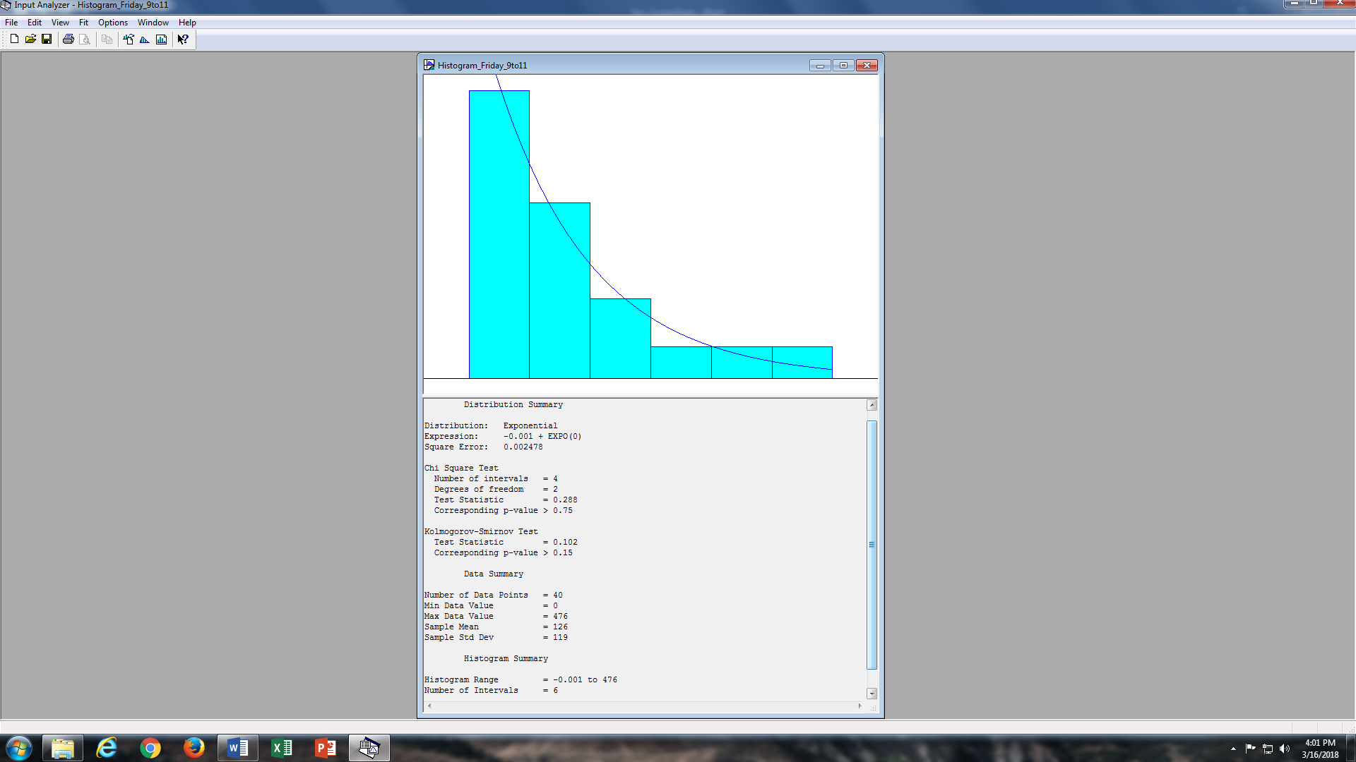
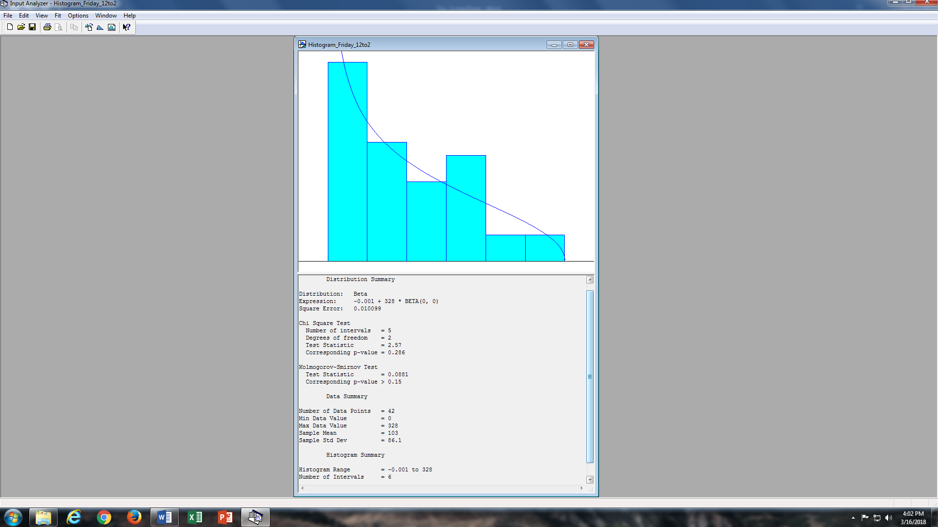
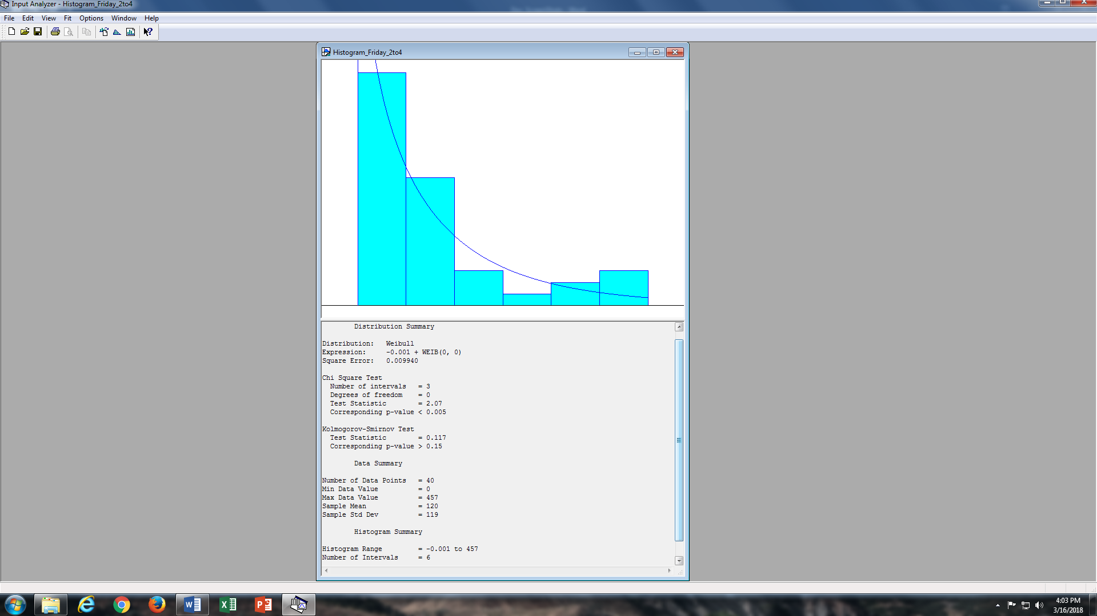
INPUT Analysis Results for Inter-Arrival Times on Friday

Slide 9




DATA VALIDATION
Initially models are developed to generate simulated arrival times and service times for all the days.
Then the generated data is compared with the actual collected data and analyzed.
SPSS IS THE TOOL USED FOR OUR DATA VALIDATION.

Slide 10
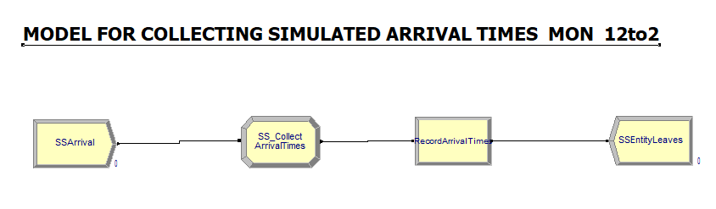
MODEL DEVELOPED FOR MONDAY AFTERNOON ARRIVAL TIMES

Slide 11
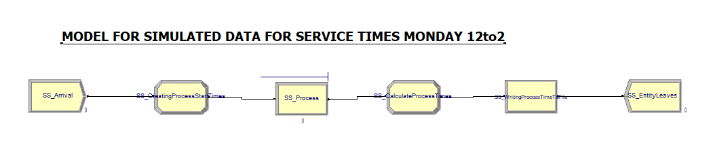
MODEL DEVELOPED FOR MONDAY AFTERNOON SERVICE TIMES

Slide 12
Normality and Homogeneity Tests using SPSS Tool
Anova Test Statistics
IntArr
Levene Statistic | df1 | df2 | Sig.
.057 | 1 | 11463 | .812
ANOVA
INTARRTIMES
 | Sum of Squares | df | Mean Square | F | Sig.
Between Groups | 133.189 | 1 | 133.189 | .029 | .864
Within Groups | 51860392.674 | 11463 | 4524.155
Total | 51860525.863 | 11464

Slide 13
Normality and Homogeneity Tests using SPSS Tool- Service Times
Levene Statistic | df1 | df2 | Sig.
.146 | 1 | 12368 | .702
ANOVA
SERVICETIMES
 | Sum of Squares | df | Mean Square | F | Sig.
Between Groups | 508.158 | 1 | 508.158 | .121 | .728
Within Groups | 51873291.997 | 12368 | 4194.154
Total | 51873800.154 | 12369

Slide 14
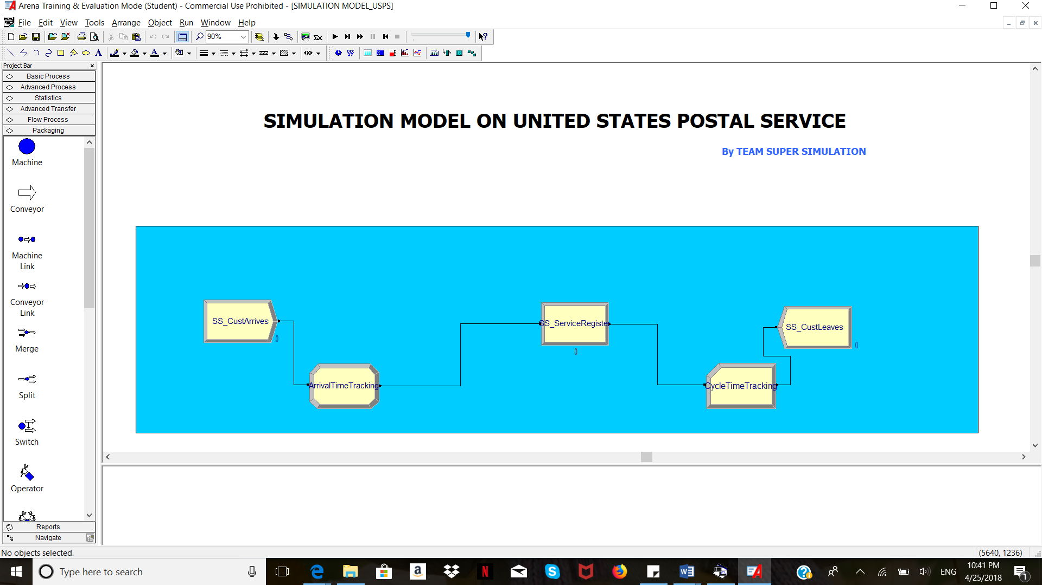

Slide 15

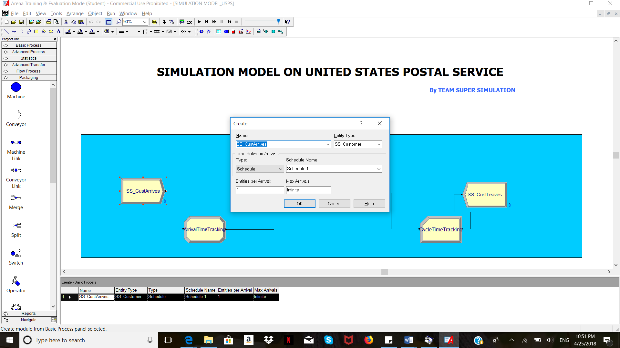
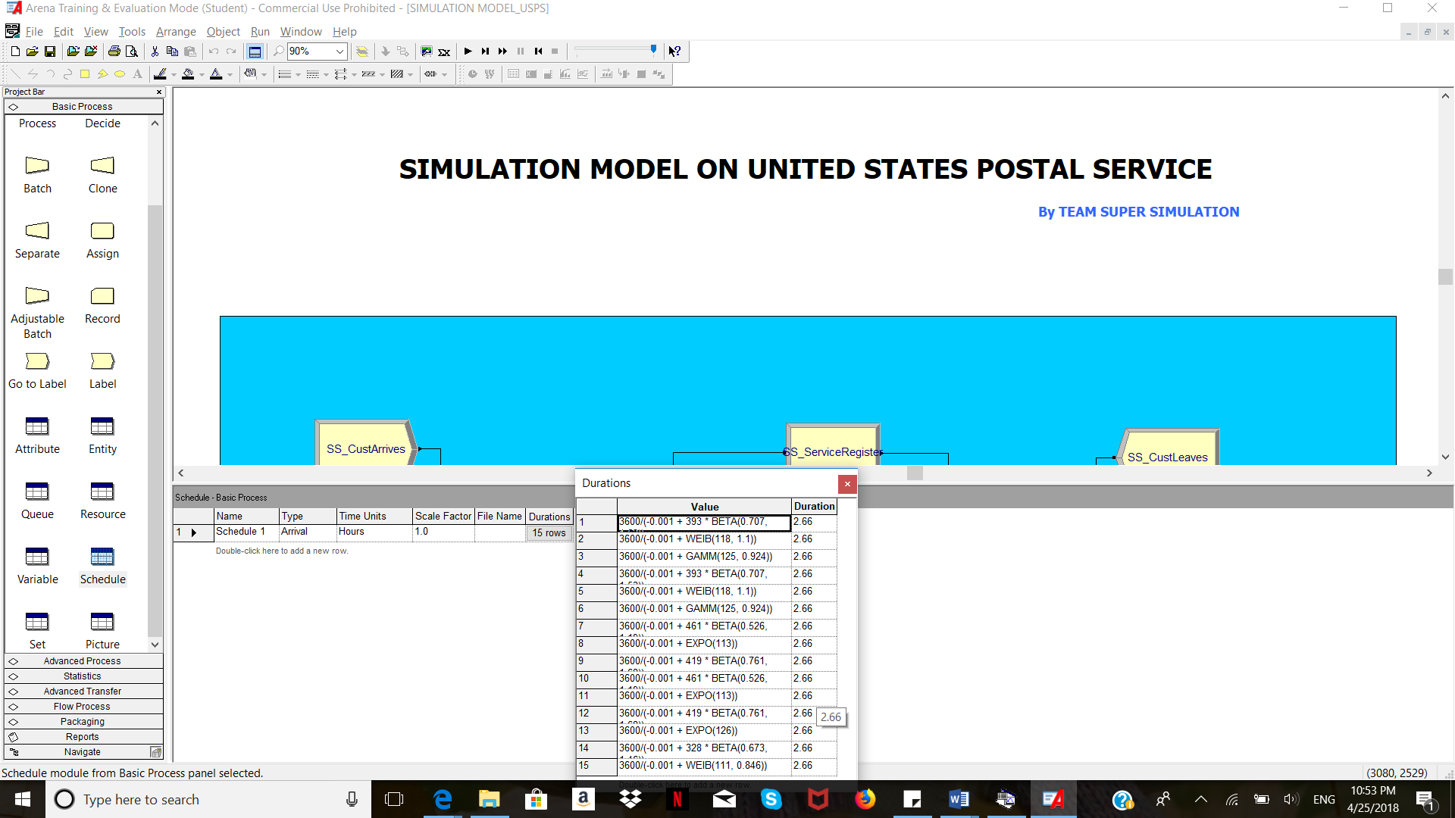
CREATE MODULE

Slide 16
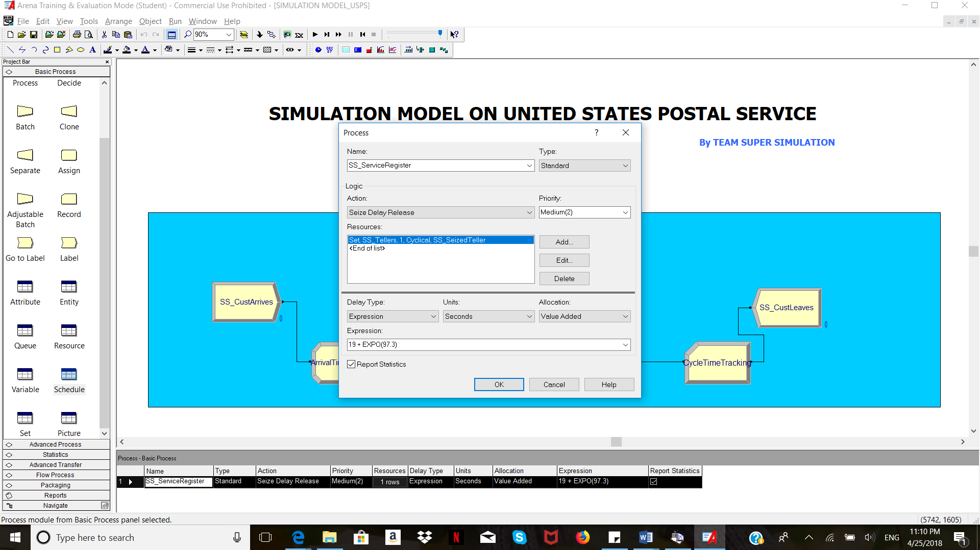
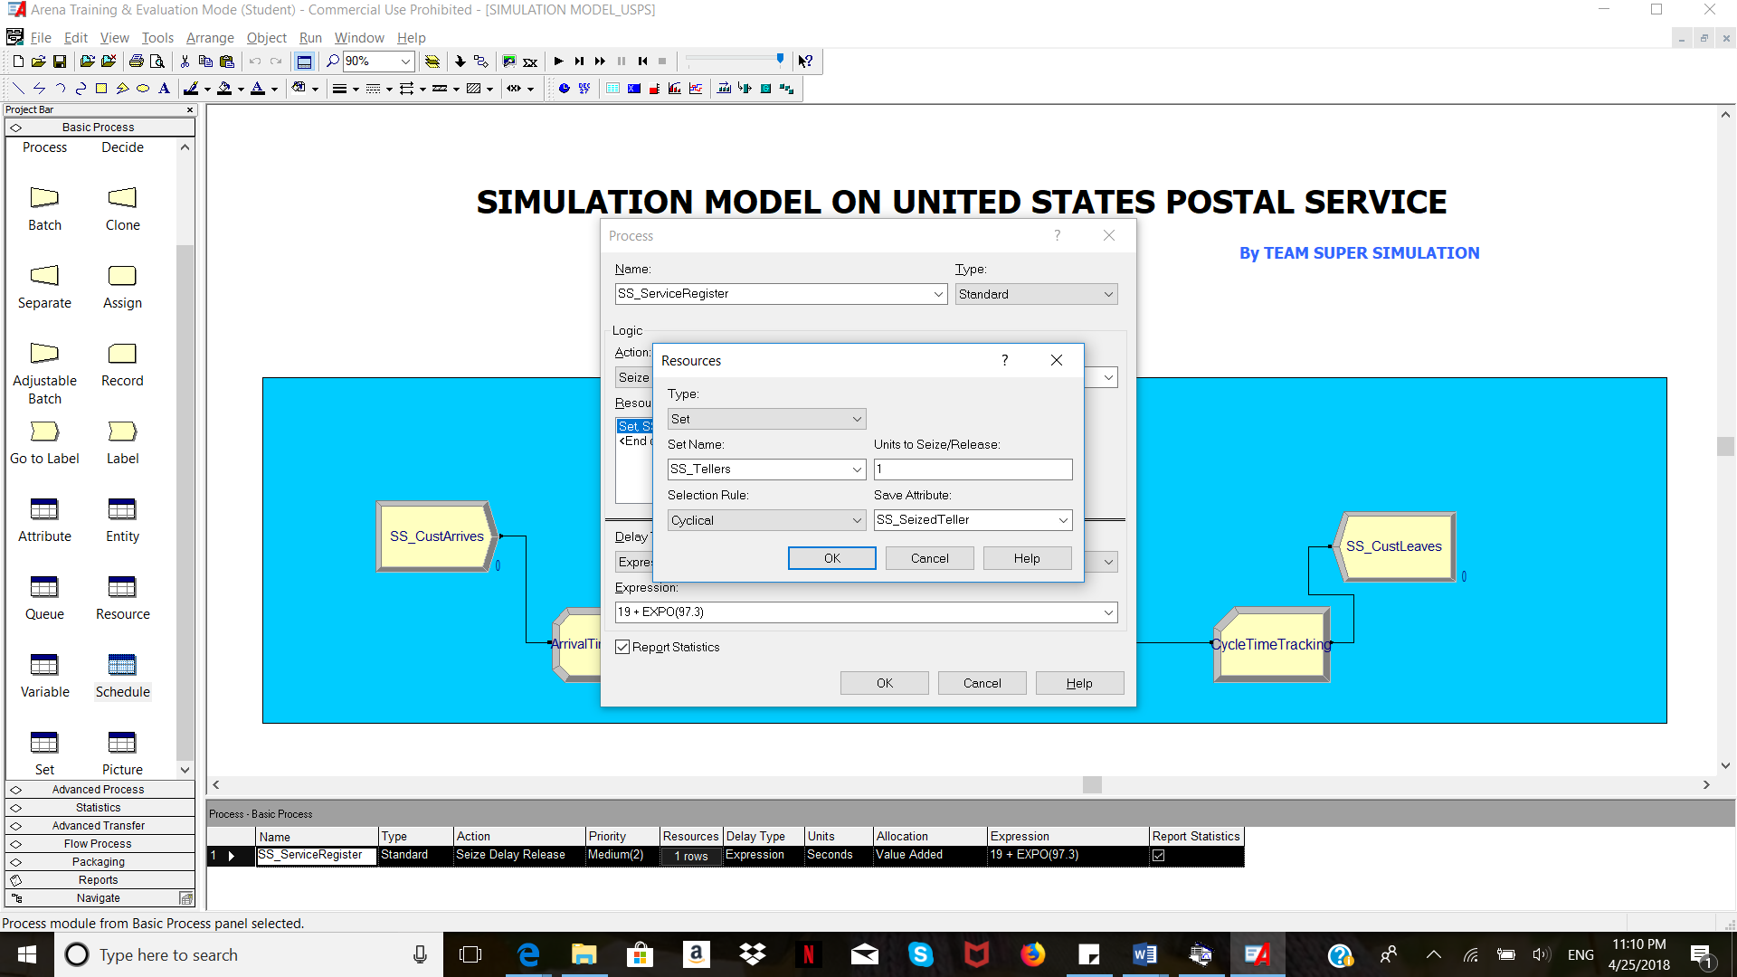
PROCESS MODULE

Slide 17
Observations from Base Model
The total time of customer in the system is observed to be high .
The no of customers being served is high.
The queue length is observed to be constantly lengthy.

Slide 18
Proposed Scenarios
Increase the number of tellers by 1
Increase the number of tellers by 2

Slide 19
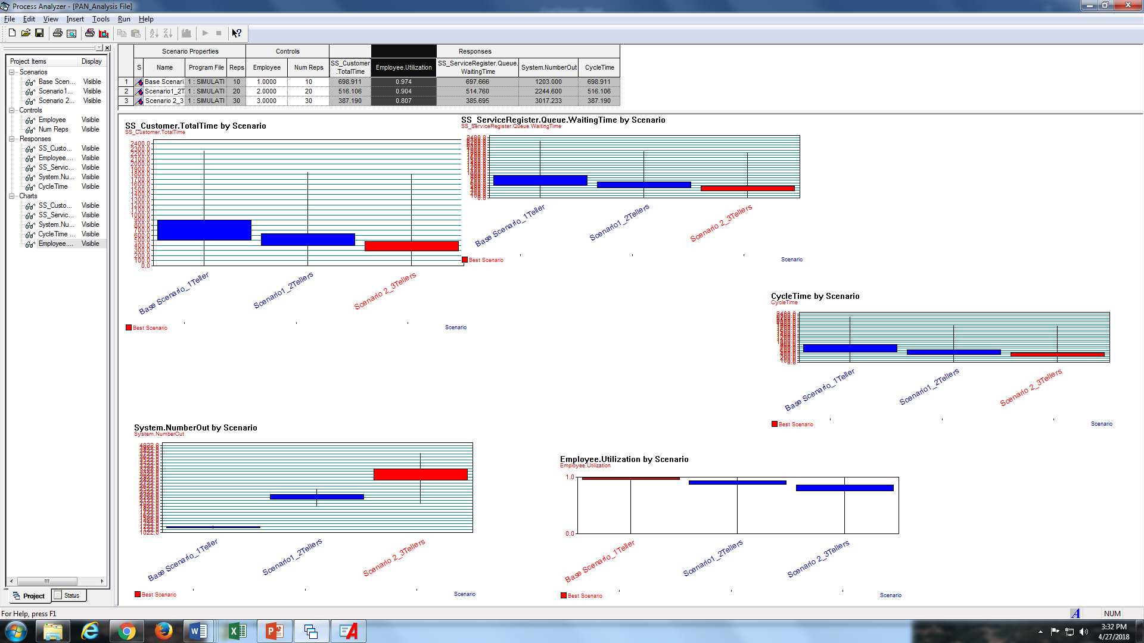
PAN ANALYSIS
Base Scenario : System with 1 teller
Scenario 1 : System with 2 tellers
Scenario 2 : System with 3 tellers

Slide 20
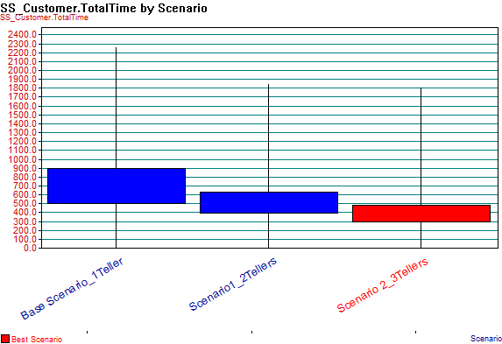
Customer Total Time

Slide 21
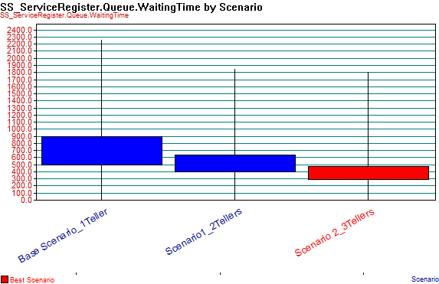
Queue. Waiting Time

Slide 22
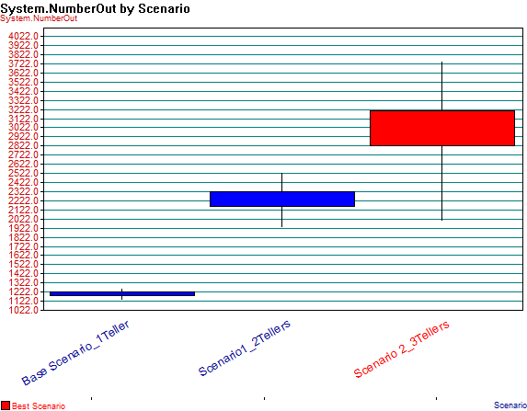
System. Number Out

Slide 23
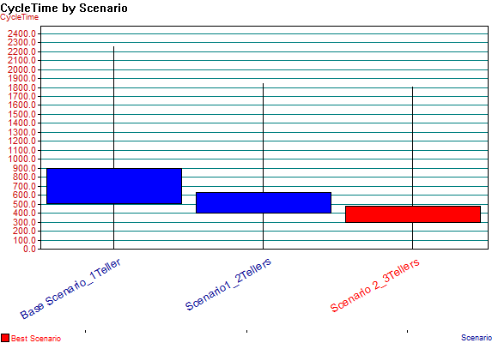
Cycle Time

Slide 24
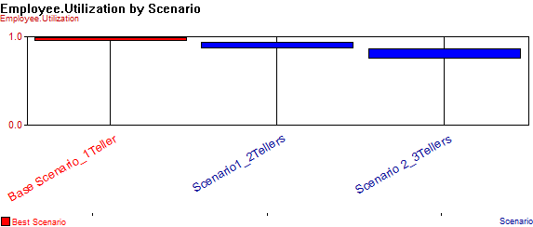
Employee Utilization
Notes:
The cost is not an issue for USPS in the situation under consideration. We are providing a solution for increasing the productivity regardless of the cost.

Slide 25
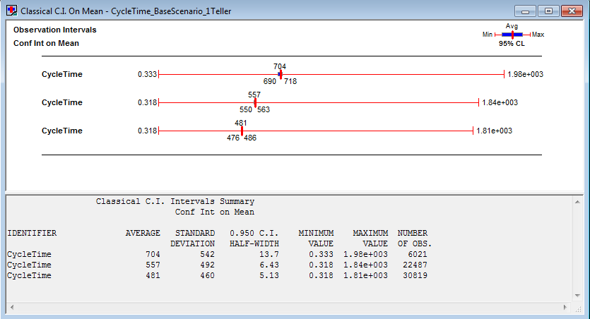
OUTPUT ANALYSIS – Confidence Interval on Mean Cycle Times

Slide 26
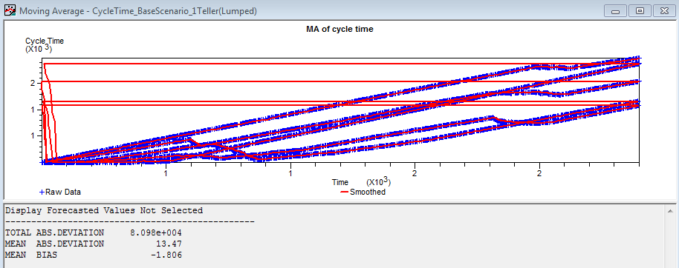
OUTPUT ANALYSIS – Moving Average of Cycle times of base scenario

Slide 27
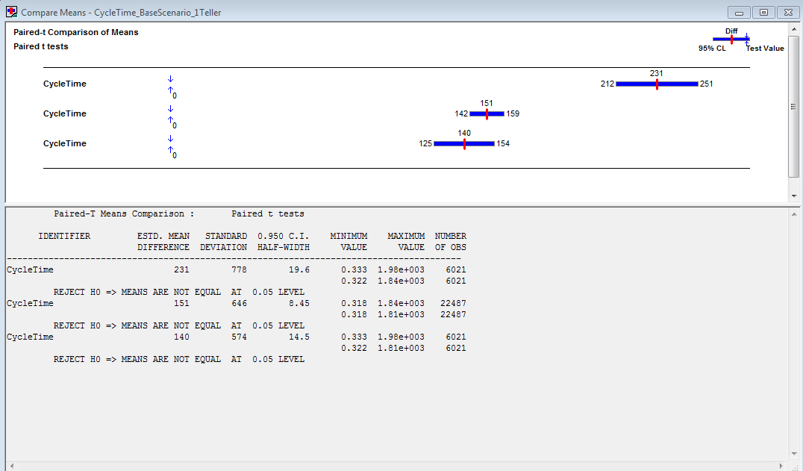
OUTPUT ANALYSIS – t Test
Notes:
and also there would be a significant improvement in performance metrics with the scenario change.

Slide 28
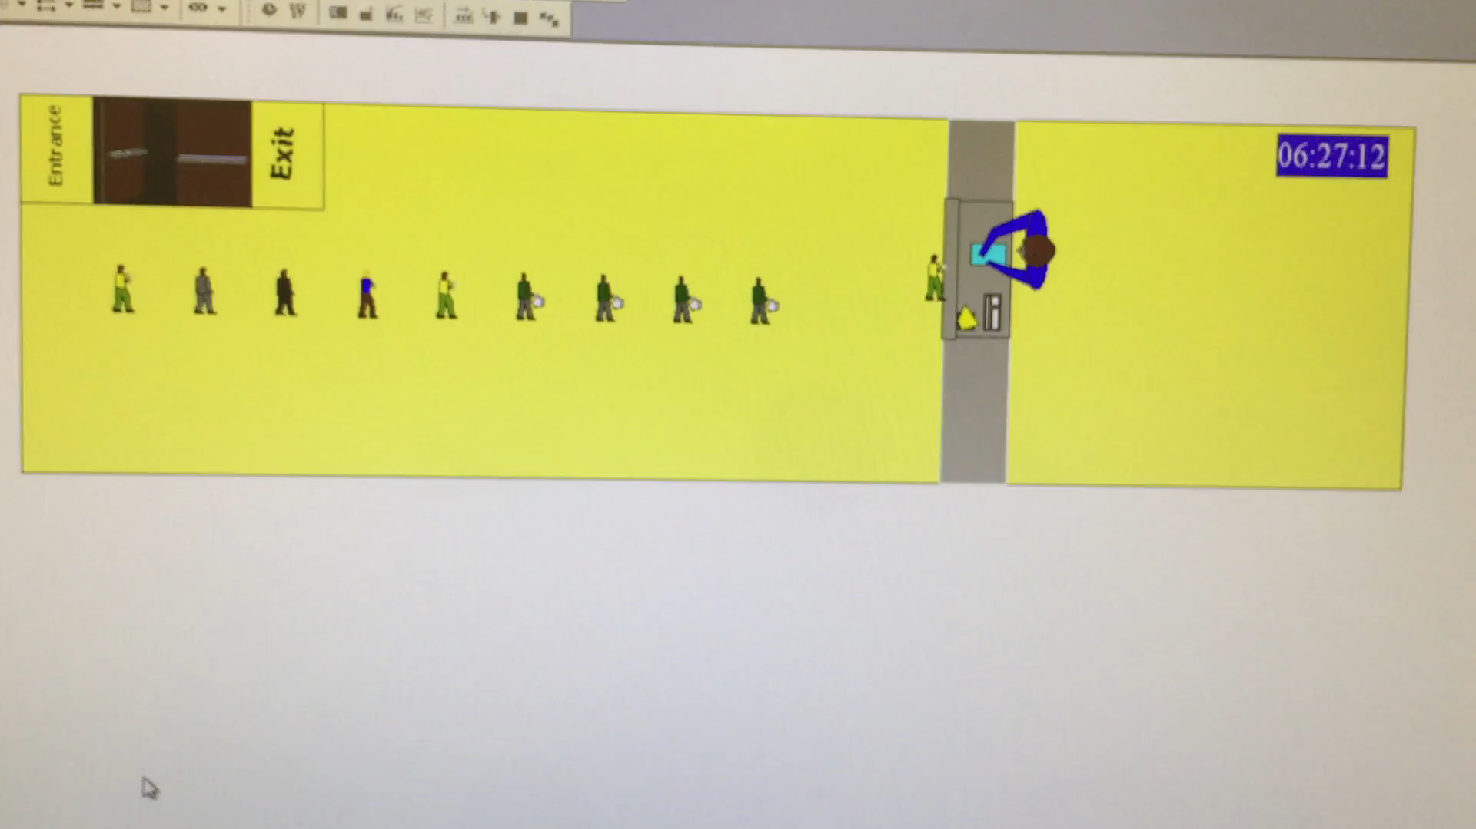
ANIMATION OF THE MODEL

Slide 29
CONCLUSION
We have come up with 2 different scenarios to improve the performance of the system.
From the extracted ARENA reports, PAN analysis results and Output Analysis results, it is observed that increasing the number of tellers will show impact on the system performance.

Slide 30
Conclusion(contd…)
It increases the number of customers out
It decreases
The cycle time,
Queue length and
Number of customer waiting in the queue.
Hence if the present USPS system can employ 2 more tellers and make it a system with 3 servers, it can improve its performance metrics and as well as can improve their customer satisfaction levels.

Slide 31


